Slide 1
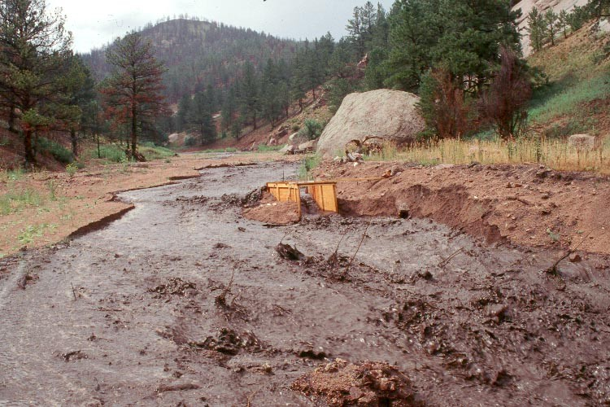
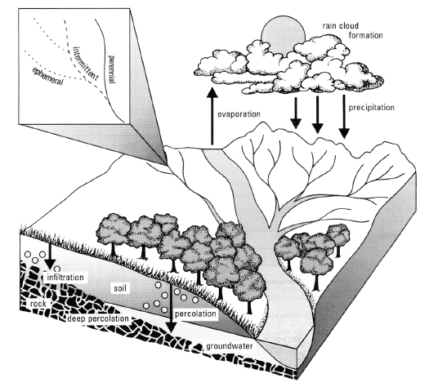
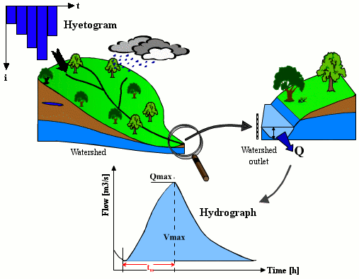
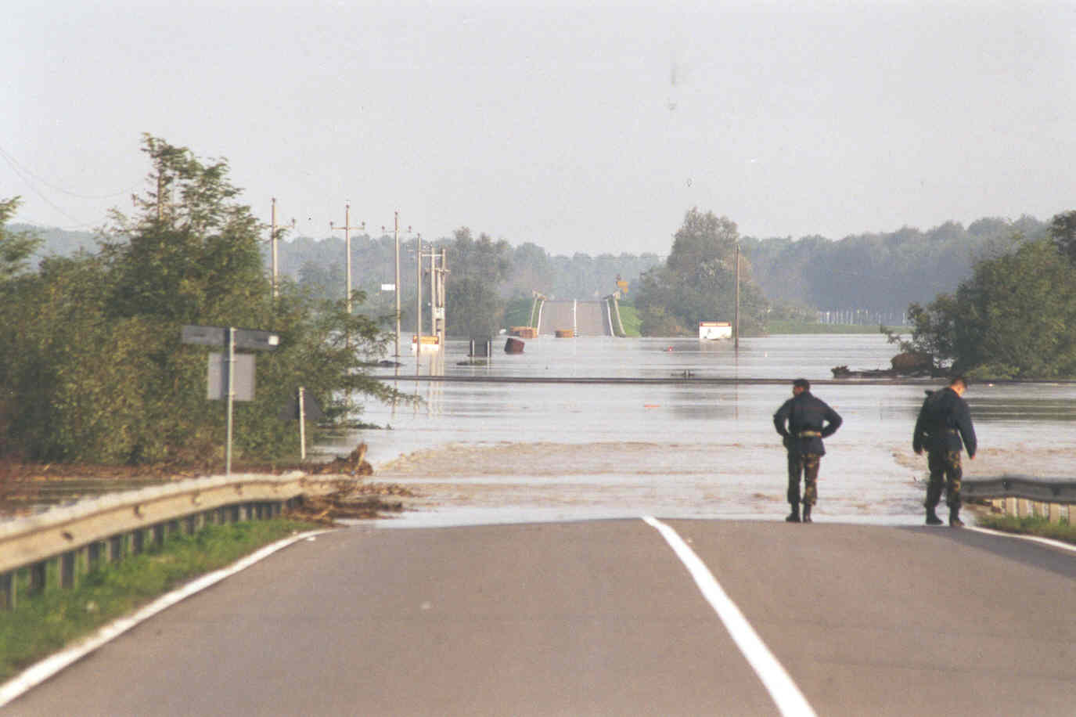
Basic Principles of Water Resources Management
Alberto Montanari
University of Bologna

Slide 2
What is Water Resources Management?
We already know the formal definition. From a practical point of view it consists of finding the best way to use water.
Basic principles for water resources management.

Slide 3
Basic Principles of Water Resources Management
Dublin principles (1992).
There is also a rich literature about principles for water resources management:
Principles related to sovranity (states can dispose of their resources without damaging other states).
Principles related to the use of resources (environmental flow etc).
Principles related to environment (sustainability etc).
Principles related to organisation and procedures (transparency, decision taken at low level of gerarchy etc).
Principles related to transboundary water resources management (equity etc).

Slide 4
What is Water Resources Management?
Integrated water resources management.
A necessary requirement is to know how much water is available, basing on synthetic or observed data. We already know how to generate data.
Once water availability is known, the subsequent fundamental step is the estimation of water demands. This requires an assessment of socio-economic conditions.
Focus is to be concentrated on irrigation demands. Civil use is the priority but irrigation demands are one order of magnitude higher.

Slide 5
Estimating water demands and water losses
A social analysis is needed to estimate the progress of population and social activities in the future.
The literature provides estimates of water demands per capita, depending on social level etc.
Water resources management planning requires a quantitative prediction of water uses in the future.
Estimation of water losses is often the most critical step. Water losses may occur in water distribution network (water supply systems, pipes, channels).
Estimation of other source or sink terms (water re-use, etc).

Slide 6
The basic tool: water balance
Water balance is the basic tool for water resources management.
It requires:
  Estimation of water availability.
  Estimation of water quality.
  Estimation of water demands.
  Estimation of water losses.
  Estimation of other water source or sink terms.
  Identification of the control volume: it is the water distribution district, sometimes enlarged to the water collection district. It can be further enlarged to include neighboring areas managed by the same water authority.

Slide 7
Water balance: critical issues
Estimation of groundwater dynamics and groundwater withdrawals.
Estimation of irrigation efficiency.
Estimation of water losses.
Estimation of future water quality.
Assessment of the impact of climate change.

Slide 8
Water balance: guidelines
Compute water balance with the level of details that is compatible with the available information (trade off with uncertainty).
Compute water balance transparently.
Clarify uncertainty and explain its effect on the results.
Involve stakeholders in decision making.

Slide 9
The management phase
Evaluation of current strategies for the use of water.
Assessment of the efficiency of the current configuration and possible room for improvement.
Evaluation of the possible alternatives for future water resources management.
Identification of a decision criteria.
Identification of the best option.

Slide 10
Sustainability of a decision
Strategies for water resources management often have an impact on the environment.
Strategies can be based on:
  Mobilising more water;
  Water savings (including more efficiency in water use).
Water savings have the priority today. Where water savings are not sufficient, mobilization of more water is necessary. But overmobilization must be avoided.
Care must be taken in building reservoirs.

Slide 11
Decision theory
Decision are numerically quantified by “decision variables” (example: water allocation to users).
The vector of the decision variables identifies a “decision plan”.
Decision variables are subjected to constraints, which must be identified.
Once the decision is well defined, one may use models to aid the decision, or “decision support systems”.

Slide 12
Decision theory: an example
A traditional way to solve IWRM problem is to associate to each decision plan an objective function and to optimize it.
Example: method of Lagrange multipliers.
g(X) = b

Slide 13
Lagrange multipliers: an example

Slide 14
Lagrange multipliers: an example

Slide 15
Decision theory: another example
Pairwise comparison (see contributions by Saaty)
If more than one alternatives are possible, each alternative can be assigned a weight quantifying its importance by means of pairwise comparison.
Alternatives are compared with subsequent pairwise comparisons.
We are asked to quantify the relative importance of an alternative with respect to another one, one by one.

Slide 16
Pairwise comparison: an example
Let’s suppose that we have to evaluate water resources management options and 3 criteria were identified to make the selection:
Recipient benefit RB (economic benefit for the recipient of water).
Institutional benefits IB (economic benefit for the institution).
Societal benefits SB (economic benefit for the society).
We have three benefits to which we have to assign a weight to compute a resulting total benefit (note: Pareto analysis can be used to identify non dominated solutions).

Slide 17
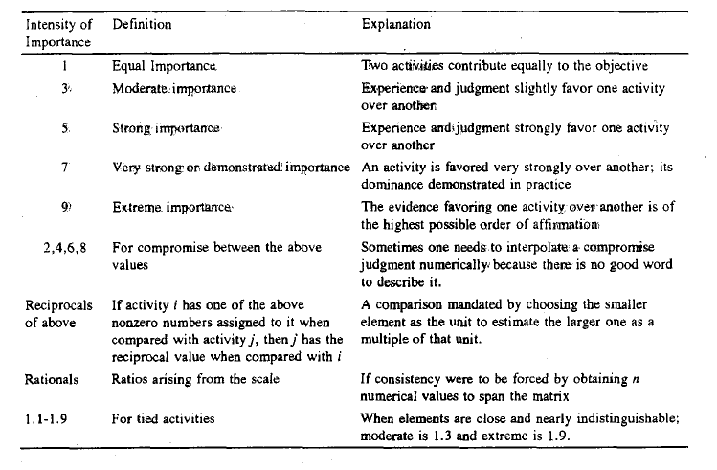
Pairwise comparison: an example

Slide 18
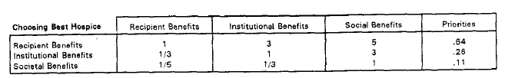
Pairwise comparison: an example
Let’s suppose that we decide accordingly to the following table.
Be careful! The evaluation is inconsistent. In fact,
if RB = 3 IB and RB = 5 SB
then 3 IB = 5 SB, namely, IB = 5/3 SB and NOT 3.
Inconsistency can be tolerated, but affects the evaluation that maybe inconsistent itself.

Slide 19
Pairwise comparison: an example
Computation of the weights to be assigned to RB, IB and SB.
1st method: make the sum of each column equal to 1 and compute the average result (it was applied above)
2nd method: make the sum of each columns equal to 1 and compute the values of the weights that have the minimum distance from the results.

Slide 20

Pairwise comparison: efficiency test
Saaty proposed the following consistency test:
where λ_{max} is the maximum eigenvalue of the matrix and n is the eigenvalue of a perfectly consistent matrix.
Saaty defined the consistency ratio as the ratio between CI and the CI of a matrix where judgments are randomly selected (but reciprocal are correctly computed).
Saaty provided reference values for the consistency ratio.

