Slide 1
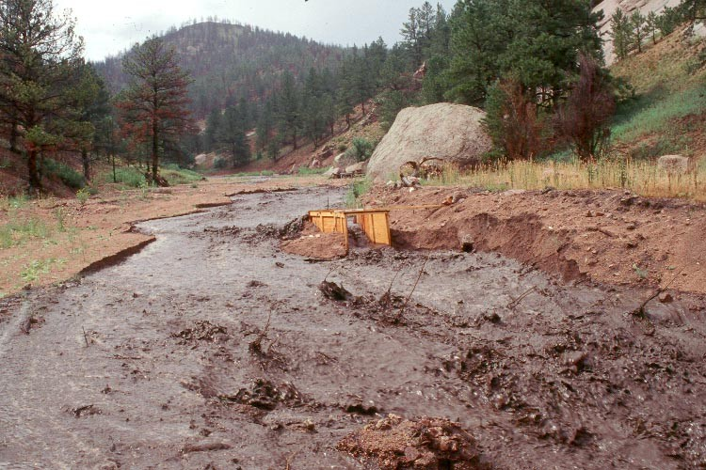
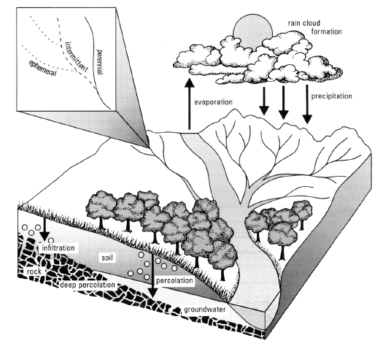
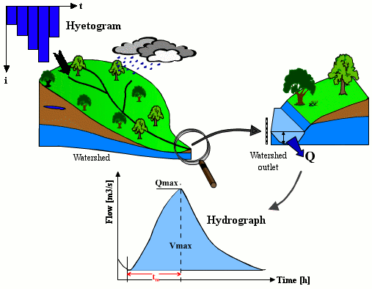
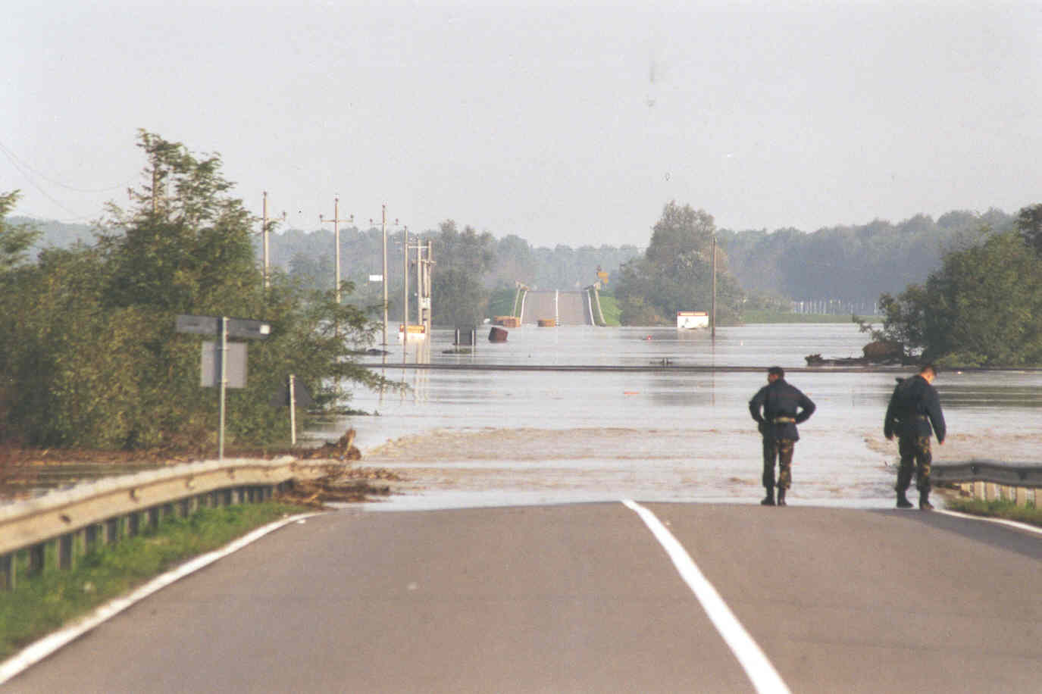
Rainfall – runoff modelling
Alberto Montanari
University of Bologna

Slide 2
What hydrology should do for water resources management?
Hydrology should provide the required information to water resources managers:
Water Resources Availability.
Water Quality.
Technical strategies for managing water resources.
Issue 1 is compelling.
Lack of historical information and problems related to river discharge measurement make estimation of water resources availability a relevant technical problem.

Slide 3
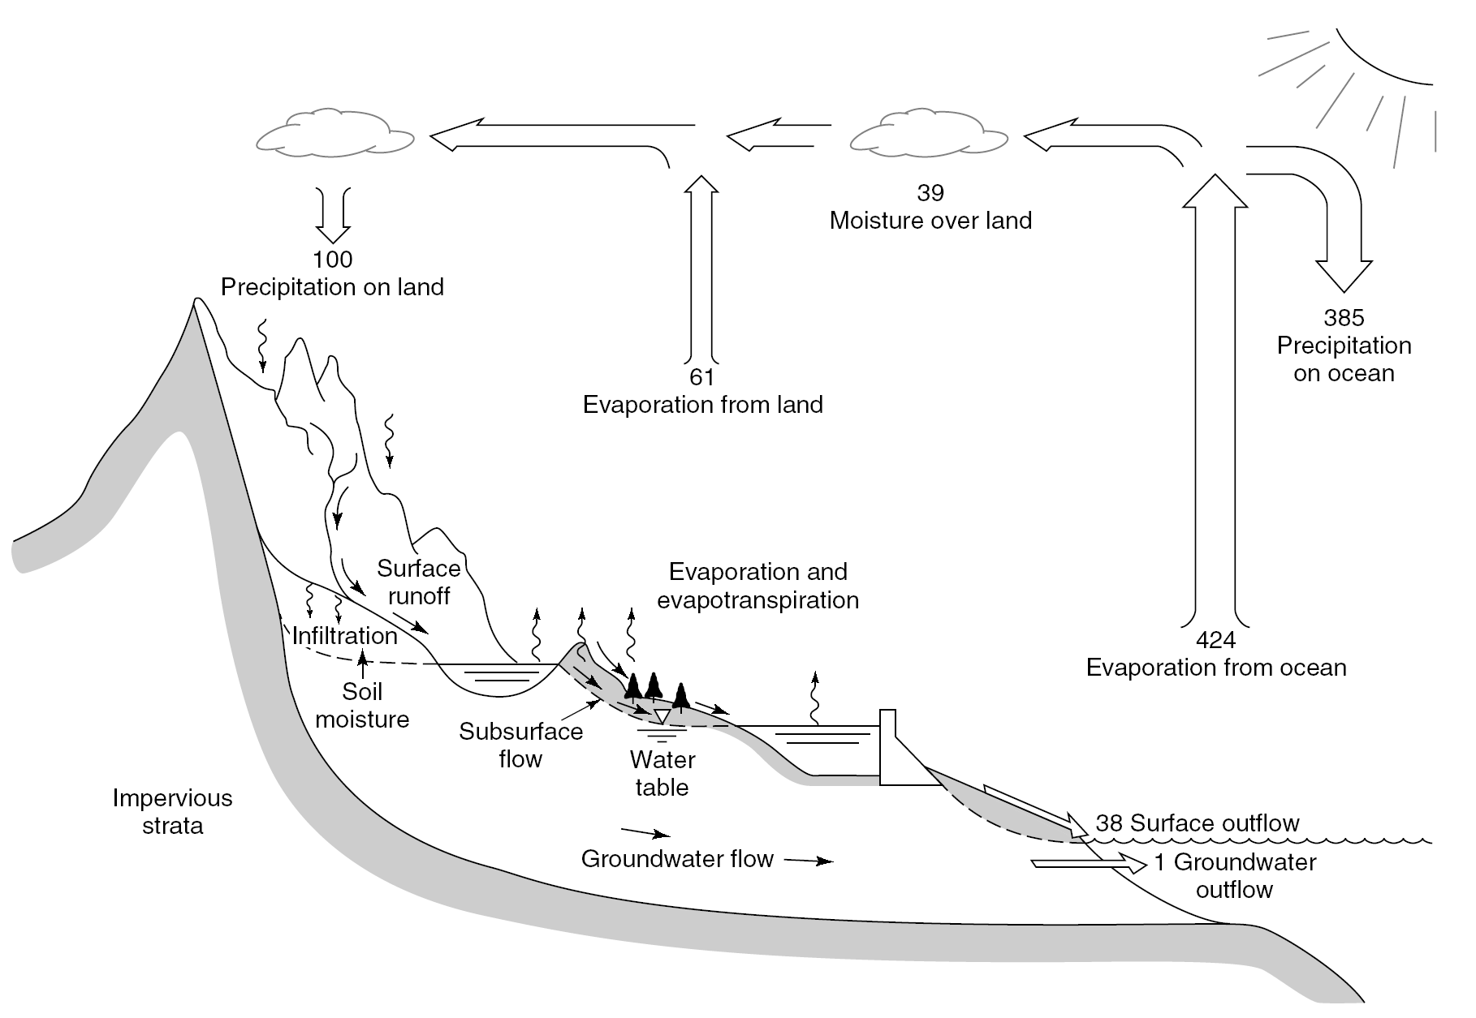
Hydrologycal cycle
Figure 7.1.1 (p. 192)
Hydrologic cycle with global annual average water balance given in units relative to a value of 100 for the rate of precipitation on land (from Chow et al. 1988)).

Slide 4
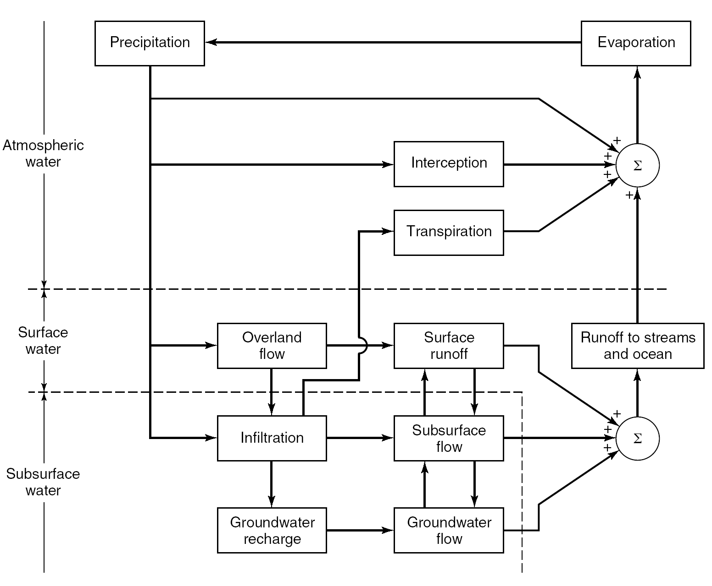
The Hydrologic Cycle as a Flowchart
Processes understanding
We want to estimate the amount of water moved by the different processes!
Figure 7.1.3 (p. 193)
Block-diagram representation of the global hydrologic system from Chow et al. (1988)).

Slide 5
How hydrological processes can be modelled?
Hydrological models try to schematise the dynamics of water flow within the water cycle. Therefore, they deal with transfer of mass which may take place in different phases (solid, liquid, gas). Such mass transfers occur through exchanges of energy.
Conservation of mass and energy are always verified in fluidmechanics, as well as Newton’s laws:
Every object in a state of uniform motion tends to remain in that state of motion unless an external force is applied to it.
The relationship between an object's mass m, its acceleration a, and the applied force F is F = ma. Acceleration and force are vectors.
For every action there is an equal and opposite reaction.

Slide 6
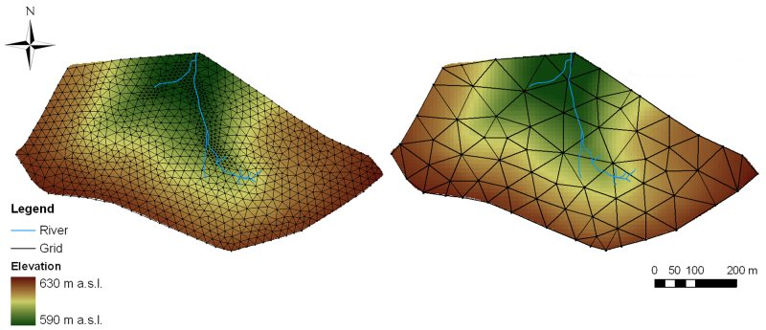
How hydrological processes can be modelled?
Therefore, if one wishes to reproduce with mathematical relationships the dynamics of hydrological processes, the continuity equation and energy and momentum conservation can be applied.
Hydrological processes are typically heterogeneous and highly varying in time and therefore the above balance equation are often expressed in differential form, by referring to elementary space units or a single particle of fluid. We can assume heterogeneity and stationarity when referring to elementary areas and infinitesimal time steps.

Slide 7

Control volume and Reynolds transport theorem
Balance equations need to be applied by referring to a control volume.
In fluid mechanics and thermodynamics, a control volume is a mathematical abstraction employed in the process of creating mathematical models of physical processes. In an inertial frame of reference, it is a volume fixed in space or moving with constant velocity through which the fluid (gas or liquid) flows. The surface enclosing the control volume is referred to as the control surface.
Balance equations for any extensive property within a control volume can be expressed through Reynolds Transport Theorem:
where B is an extensive property of the fluid (like total mass or momentum of the system), b is its intensive counter part (property per unit mass of fluid), ρ is the mass density of the fluid, V is control volume, S is its control surface, u is the flow velocity vector and n is the outgoing unit normal vector.

Slide 8
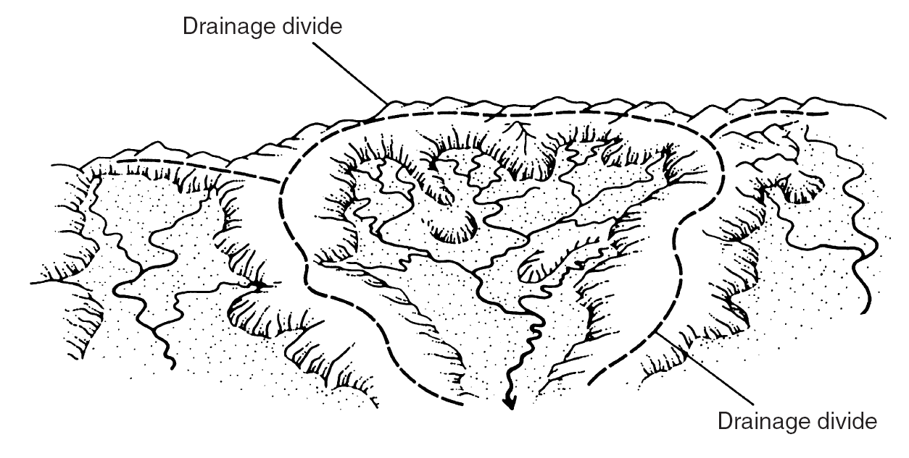
The Watershed
Figure 7.1.4 (p. 194)
Schematic diagram of a drainage basin. The high terrain on the perimeter is the drainage divide (from Marsh (1987)).

Slide 9
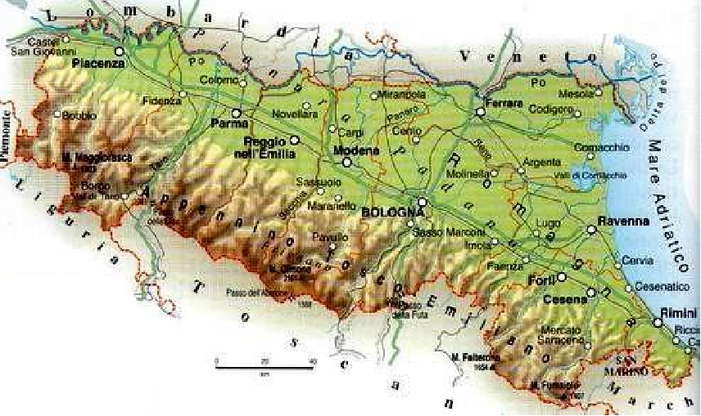
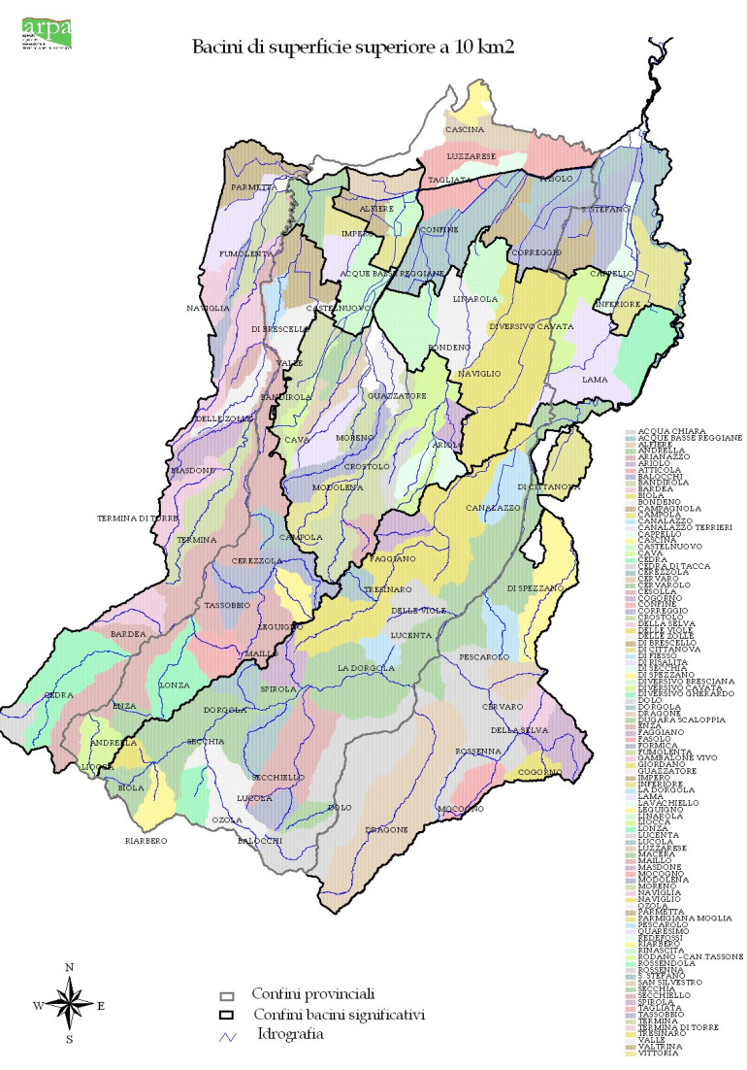
Watersheds can have many Forms and Sizes!

Slide 10
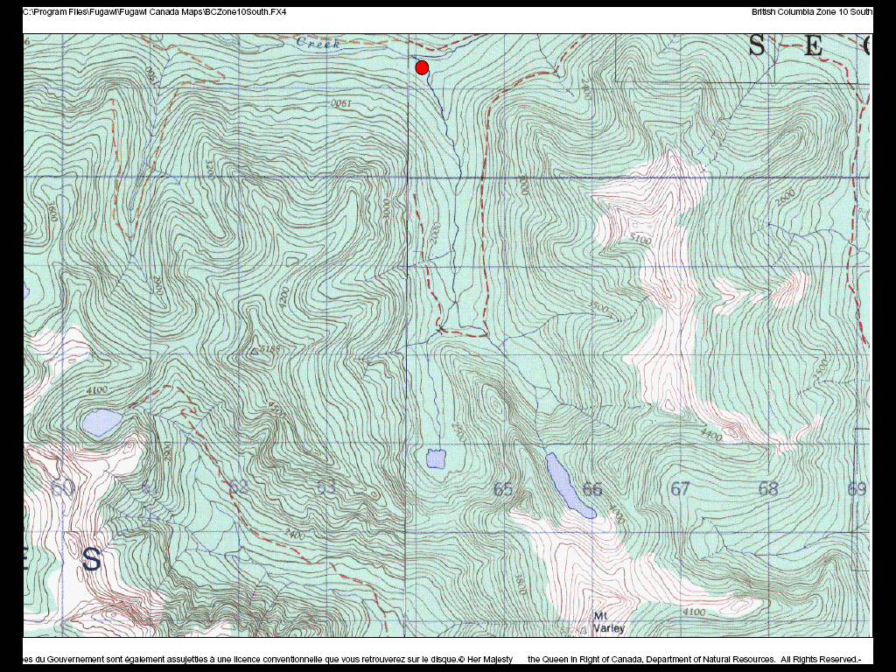
Watershed Delineation
We derive watershed divides from paper or digital maps. We start from a point on the river and move perpendicular to the contour lines to the top of the contours (the divide).

Slide 11
Rainfall-Runoff Modeling
Rainfall
Runoff
Watershed
Rainfall
Rainfall-Runoff
Model
Runoff

Slide 12
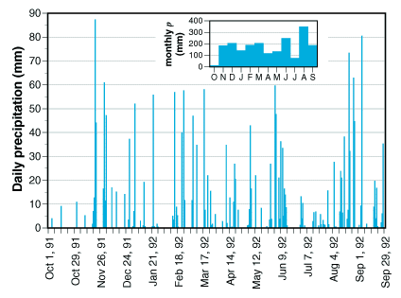
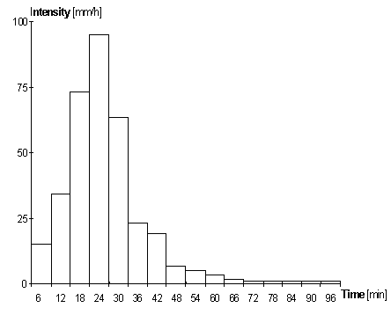
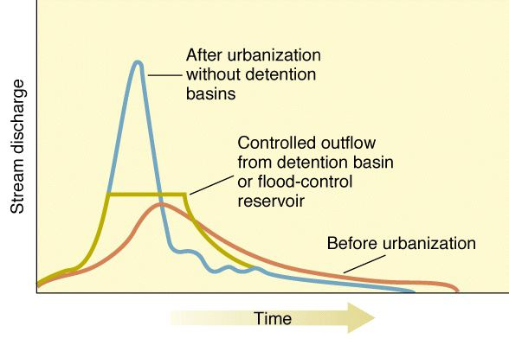
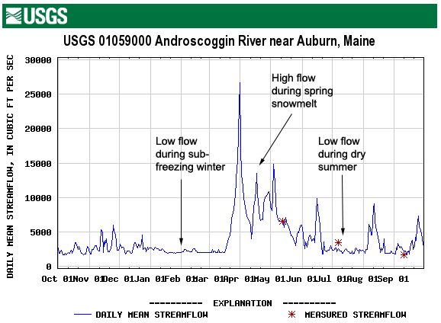
Rainfall-Runoff Modeling
Hyetograph
Hydrograph

Slide 13
Rainfall-Runoff Modeling
Input:
Simulation behaviours and requirements (time step, type of model, computational requirements….);
Catchment behaviours (soil type and use, catchment area, catchment elevation….);
River network behaviours (geometry of the cross river sections, roughness of the river bed, slope of the river bed….);
Meteorological input (rainfall, snowfall, temperature, wind speed and direction…..).
Output:
River flow (possibly in more than one cross river section…..);
Evapotranspiration, water storage…..
Design variables.

Slide 14
Rainfall-Runoff Modeling
Model structure:
Lumped vs spatially distributed;
Black box vs conceptual vs physically-based;
Event based versus continuous simulation;
Simulation models vs forecasting models.
Parameters:
A parameter is a constant or variable term in a function that determines the specific form of the function but not its general nature, as a in f (x) = ax, where a determines only the slope of the line described by f(x).
Parameters might be present in fully physically-based equations (physical properties can be considered as parameters) but usually the term parameter is reserved for quantities that are not physically measurable and compensate for approximations in physical equations.
Calibration and validation.

Slide 15
Modeling Considerations
Development of a rainfall-runoff model depends on
(1) Time scale
(2) Basin scale
Small basin operate a less significant filtering effect on rainfall.
Linear models are not appropriate for short time scales and small spatial scales.
Constant and spatially uniform rainfall typically induces a S-shaped hydrograph in the long time.
It is important to gain a full comprehension of the rainfall-runoff transformation on a perceptional basis. Go out and look around, especially during floods!

Slide 16
Rational Formula
First proposed by Kuichling in 1889
Q_{p} = C i A
  where Q_{p} = peak discharge (m³/s);
  i = rainfall intensity (m/s)
  A = drainage area (m²)
  C = runoff coefficient ( - ) depending on water losses
Note: i = average intensity of rainfall corresponding to the
      duration of time-to-concentration.

Slide 17
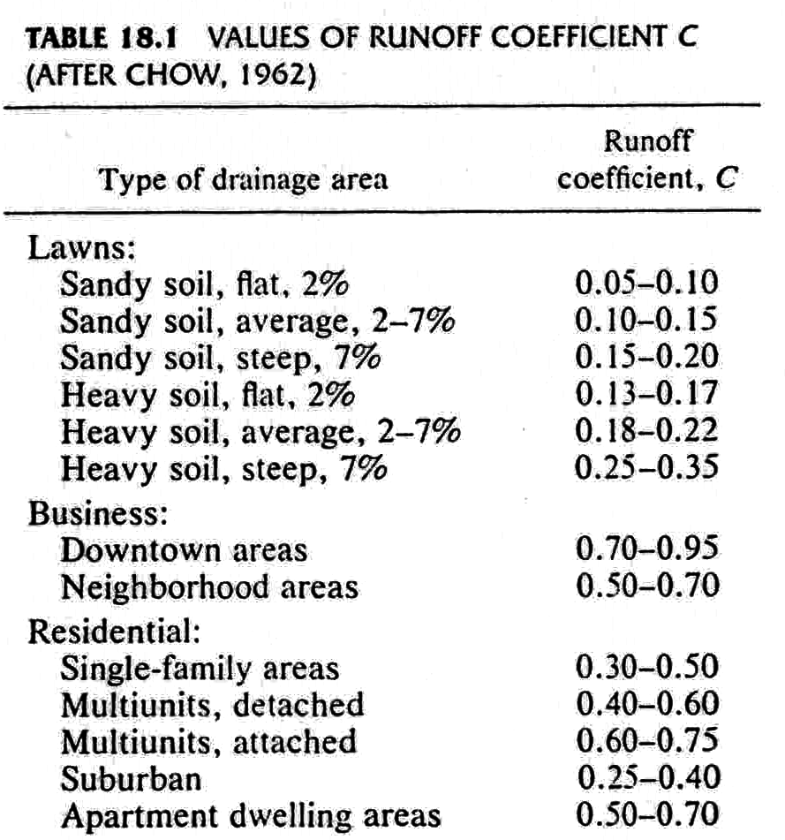
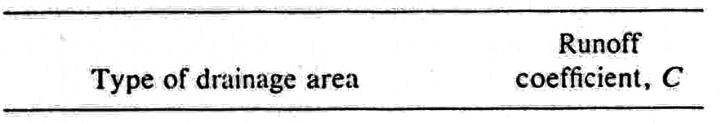
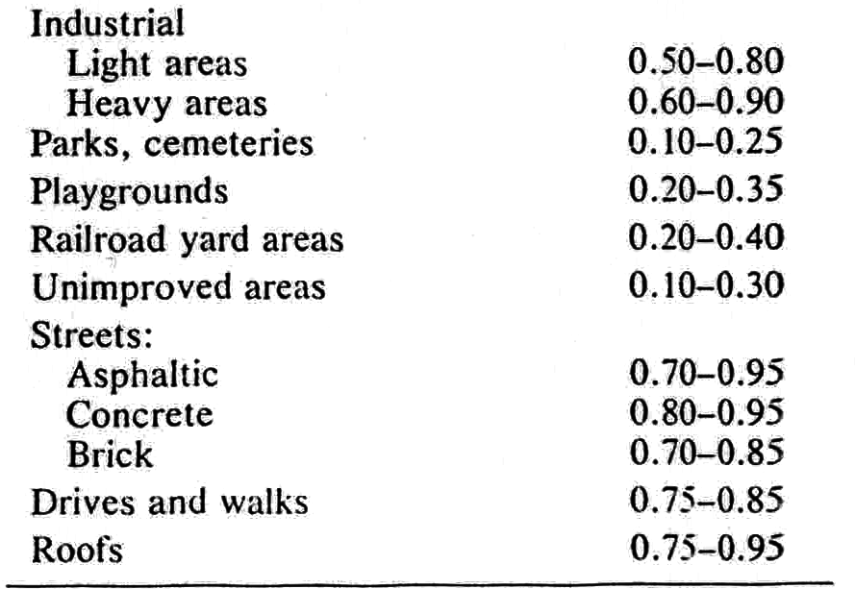
Time-of-Concentration
Definition: the time needed for water to flow from the most remote point in a watershed to the watershed outlet. It is very difficult to measure.
Runoff coefficient
Again, it is very difficult to measure.

Slide 18
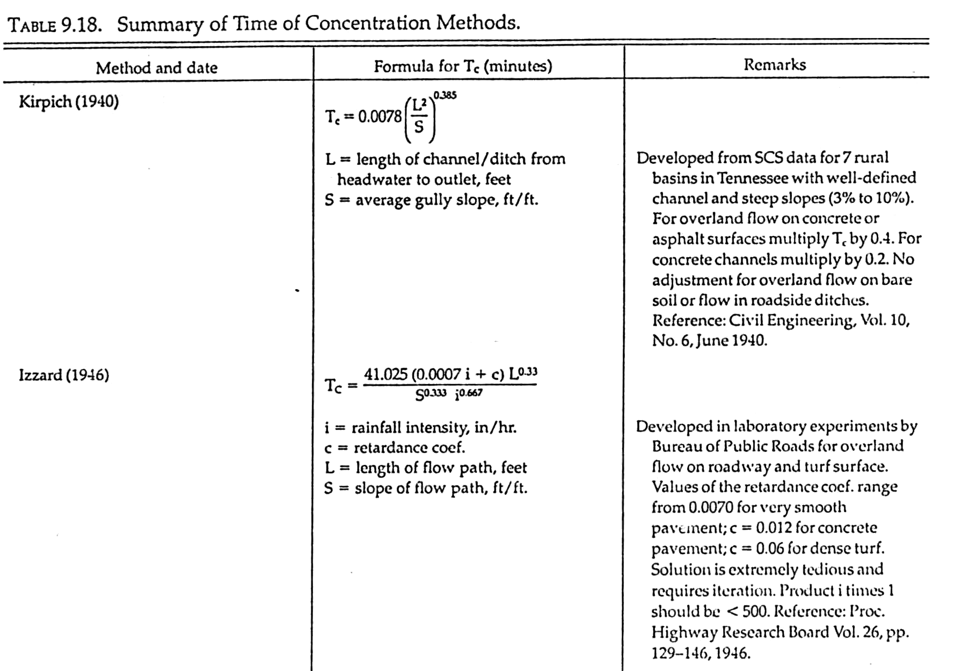
Time-of-Concentration Methods (1)

Slide 19
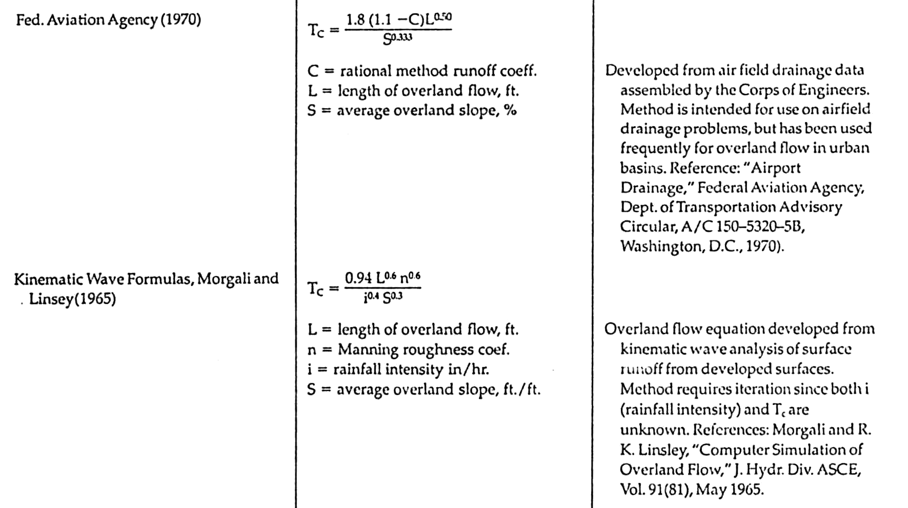
Time-of-Concentration Methods (2)

Slide 20
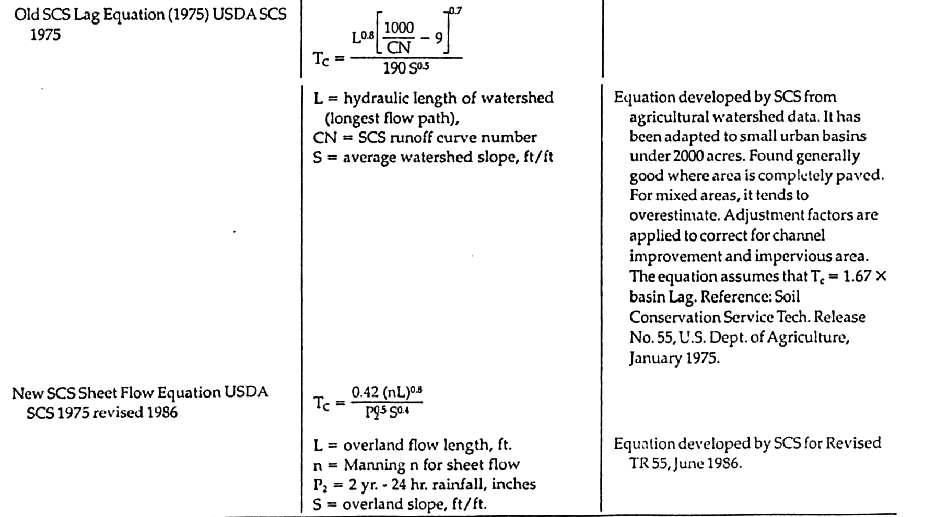
Time-of-Concentration Methods (3)

Slide 21
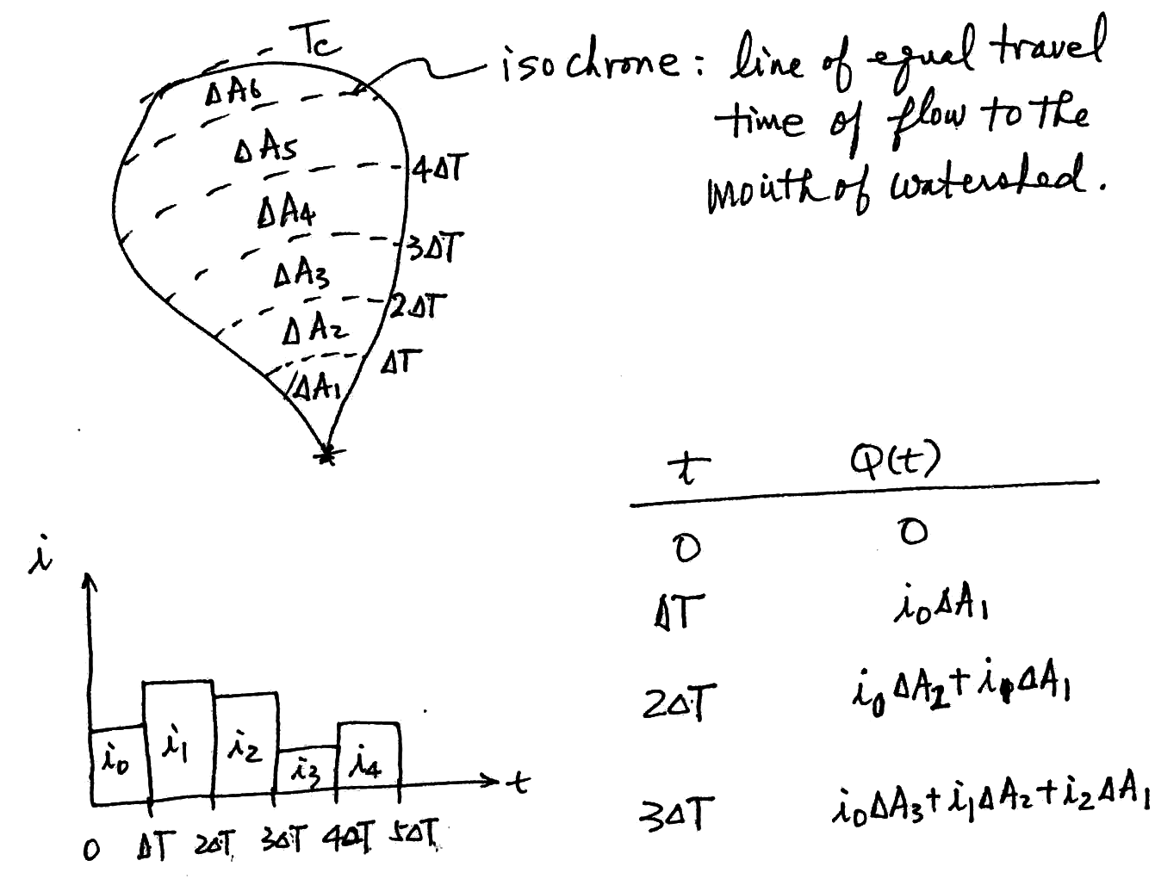
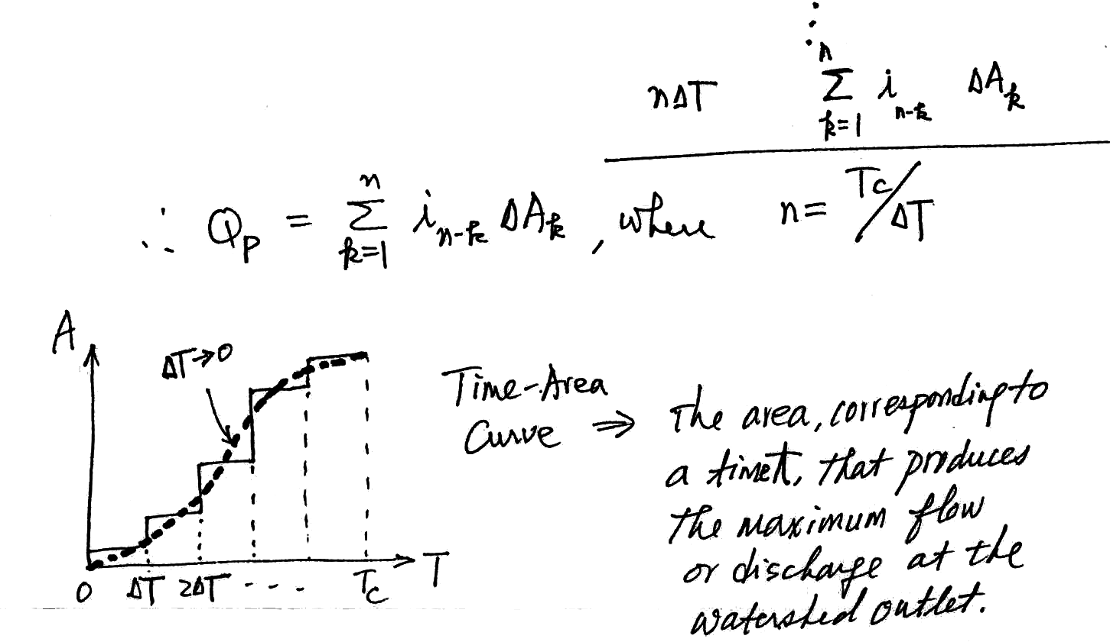
Time-Area Method
Can be considered as an extension of the rational method in which rainfall intensity in not uniform over the storm duration

Slide 22
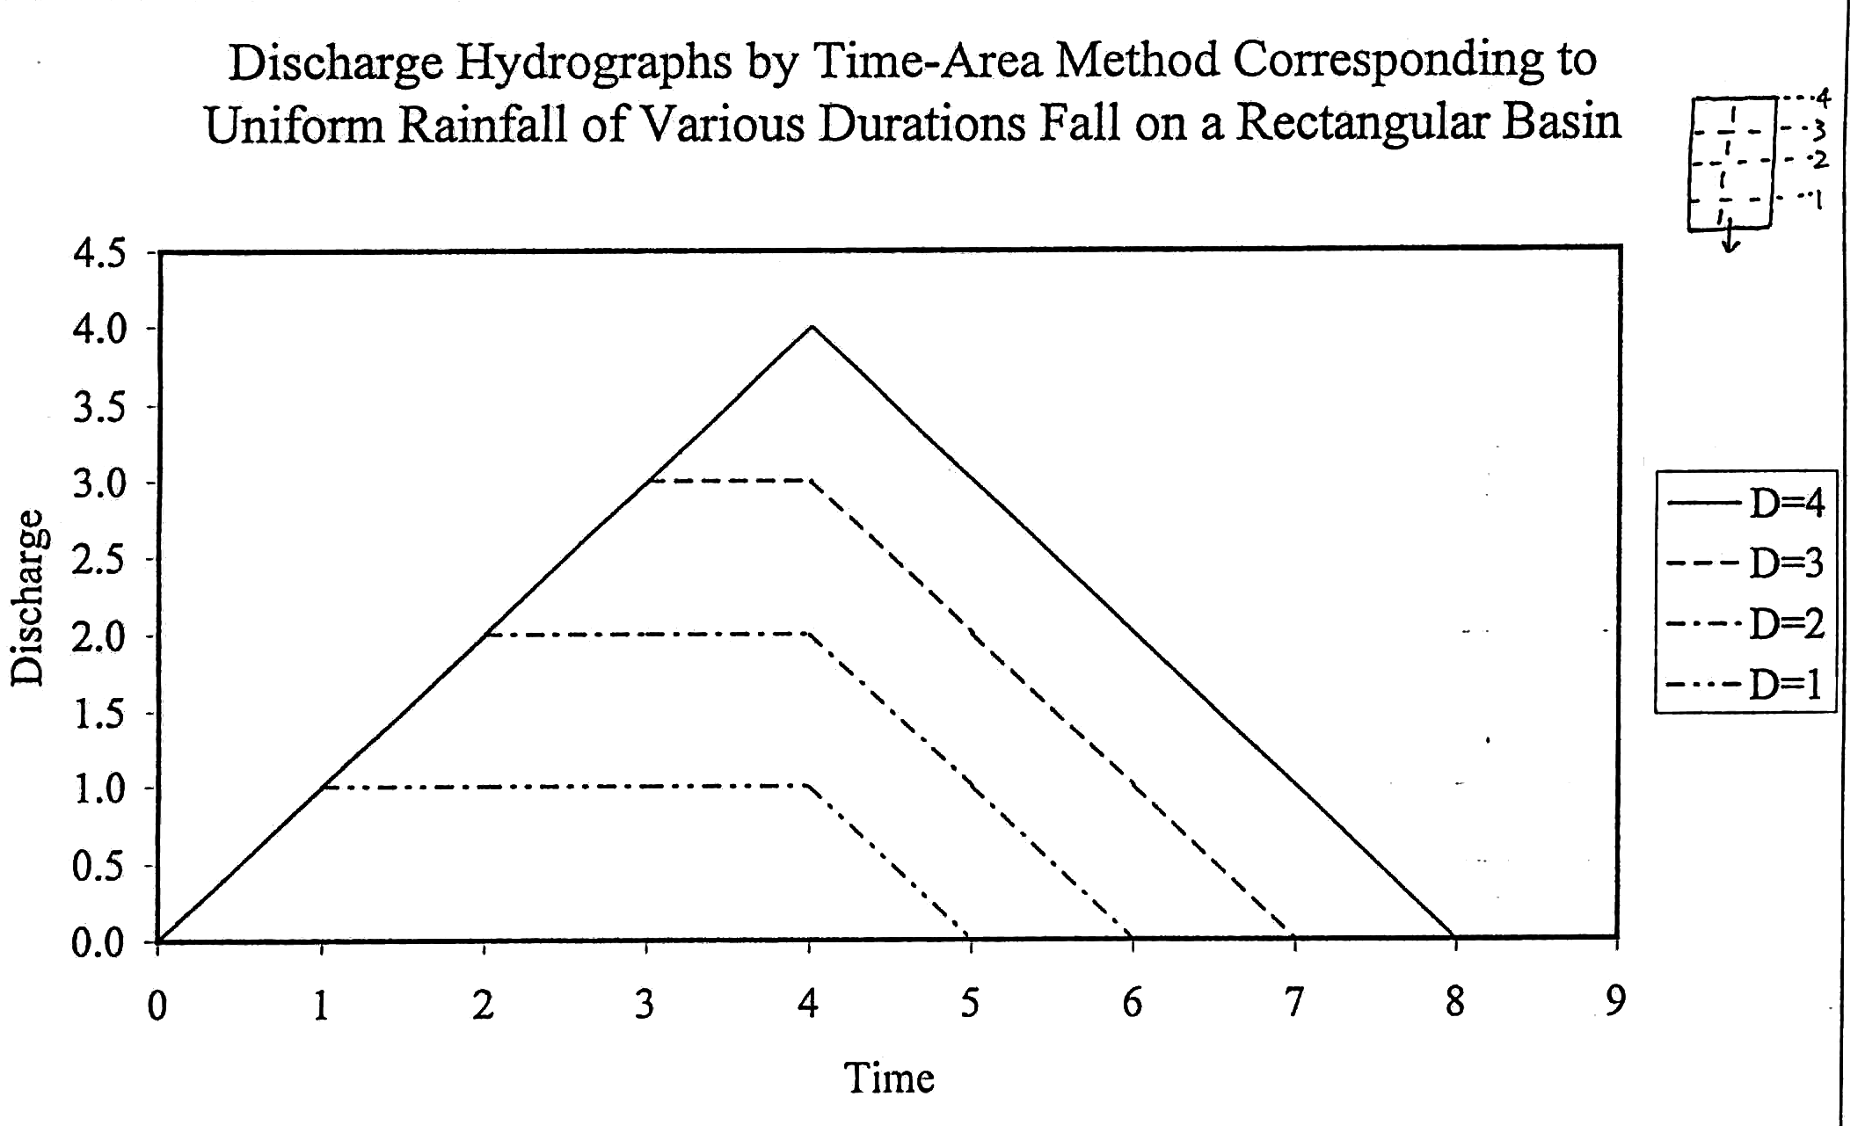
Time-Area Method (Eg. 1)

Slide 23
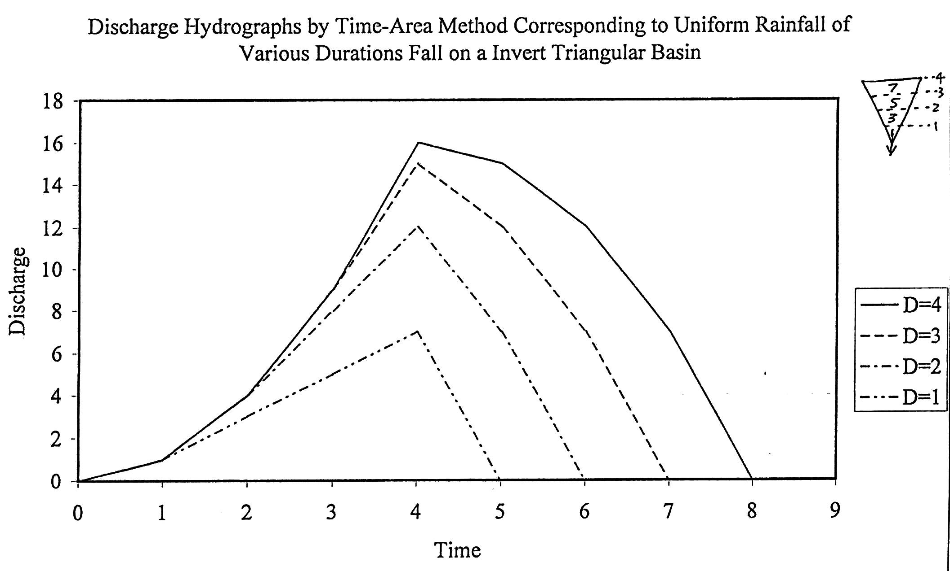
Time-Area Method (Eg. 2)

Slide 24
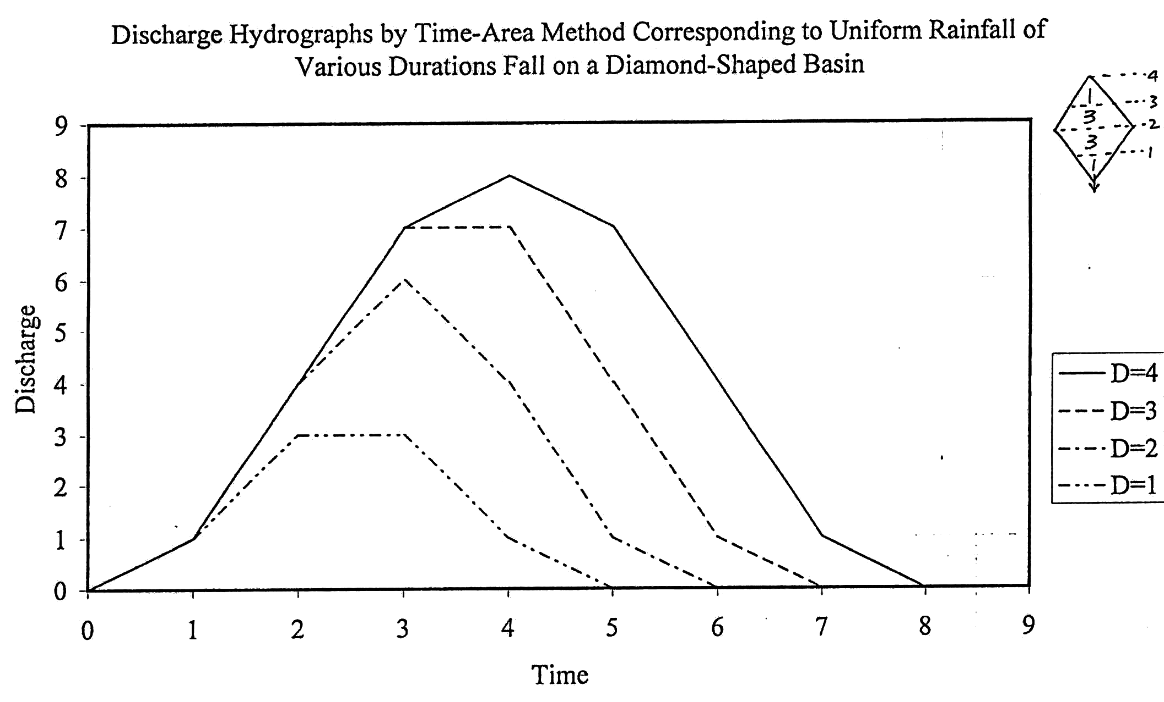
Time-Area Method (Eg. 3)

Slide 25
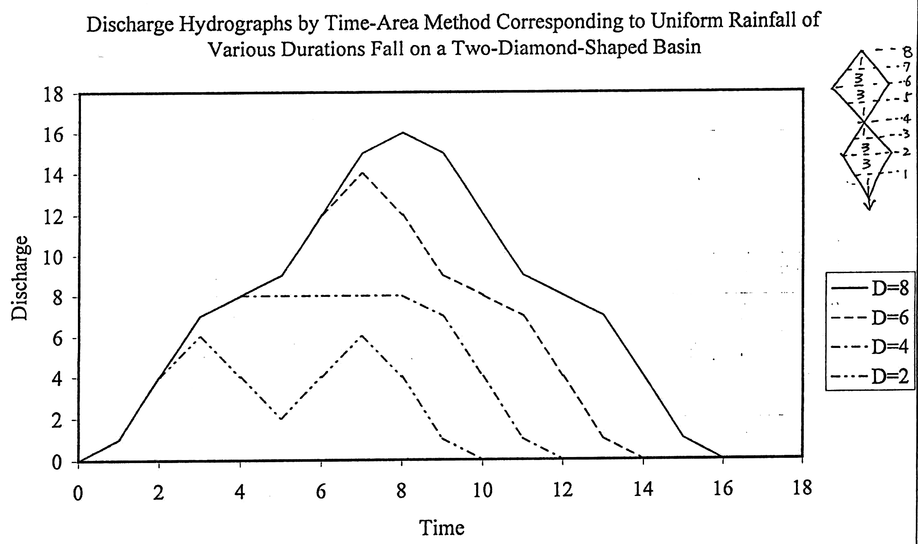
Time-Area Method (Eg. 4)

Slide 26
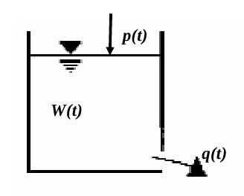

Linear Reservoir Method
Accordingly to this model, the catchment is assimilated to a reservoir and the river discharge at the outlet is assumed to be given by the outflow from a bottom discharge.
The discharge is assumed to be related to the stored volume by a linear relationship:
which can be considered an empirical expression of an energy balance equation (Torricelli’s law).

Slide 27


Linear Reservoir Method
We can also impose the continuity equation to the reservoir:
which can be considered an empirical expression of an energy balance equation (Torricelli’s law).
By combining one obtains:

Slide 28


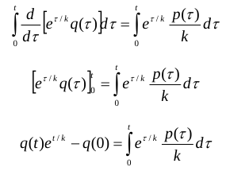
Linear Reservoir Method
By multiplying both sides by e^{t/k} one obtains:
which can be written as:
By integrating between 0 and t one obtains:

Slide 29

Linear Reservoir Method
By imposing q(0) = Q₀ one obtains:
+ Q₀ e^{-t/k}
Please note:
River discharge is linearly related to the river cross section area;
assuming a linear relationship between river discharge and water stored in the catchment implies a linear relationship between cross section area and water volume stored in the catchment.
This means that the virtual water level shift is uniformly distributed over the catchment (synchronous functioning)

Slide 30



Generalisation of linear methods
Linear reservoir (by neglecting Q₀):
Time-area method:
T

Slide 31

Generalisation of linear methods
By generalising:
where h(t) is called the Instantaneous Unit Hydrograph (IUH). It is the response of the catchment to an (instantaneous) impulse of rainfall of unit volume.
Note: for linear systems the principle of superposition of the effects applies.
In general, it is not a suitable assumption (but depends on catchments size and time scale).
Many different IUHs are proposed by the scientific literature.

Slide 32
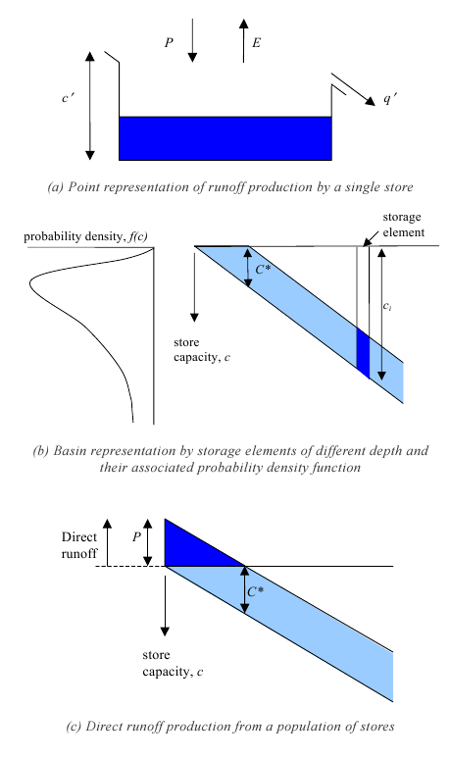
Variable source area models
Actually, in a river basin the water storage capacity is spatially varying.
Figure 2 from Moore, R. J.: The PDM rainfall-runoff model, Hydrol. Earth Syst. Sci., 11, 483-499, doi:10.5194/hess-11-483-2007, 2007

Slide 33
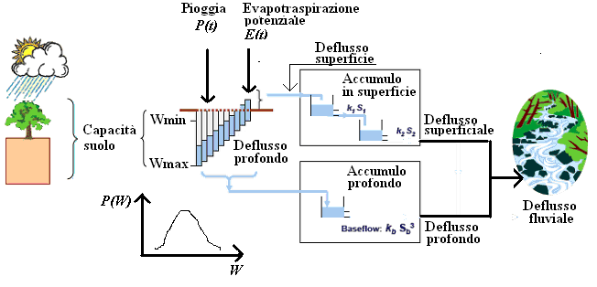
Variable source area models (non linear)

Slide 34
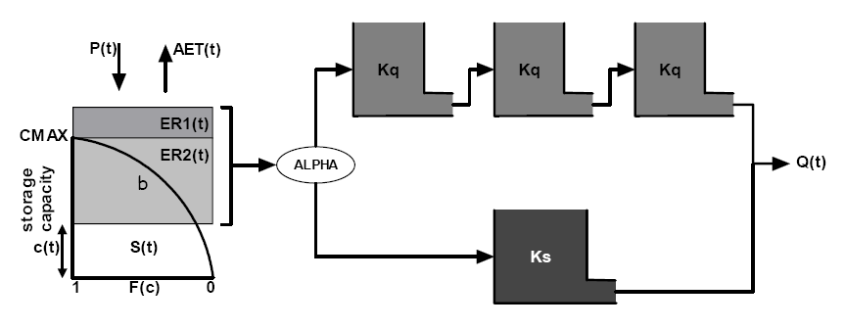
Hymod model
Water storage capacity

Slide 35
Hymod model
Assumption: evapotranspiration is null and cumulated rainfall from the beginning of the event is indicated as P(t)
W(t) is the volume of water stored in the catchment per unit catchment area

Slide 36
Hymod model

Slide 37
Hymod model
se
C* is now the storage in the unsaturated part of the catchment

Slide 38
Hymod model
E_{P}(t) is potential evapotranspiration
E(t) is actual evapotranspiration

Slide 39
Hymod model
After subtracting evapotranspiration, at each time step, C*(t) is recomputed through the relationship:
Note again that C*(t) is the water depth that is stored in the part of the catchment that is not saturated.

Slide 40
Hymod model
The runoff is divided in two components through a parameter a. The two components are routed through a linear reservoir (slow component) and a cascade of three reservoir with the same K value (fast component).
Then, the model counts a total of 5 parameters.

