Slide 1
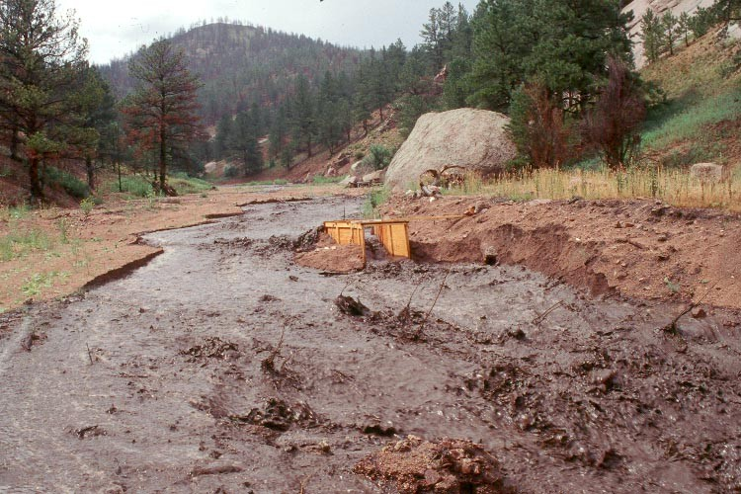
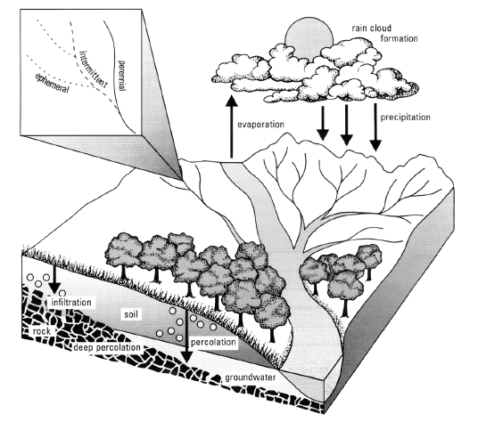
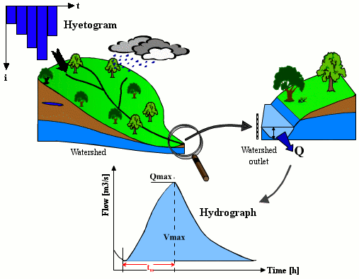
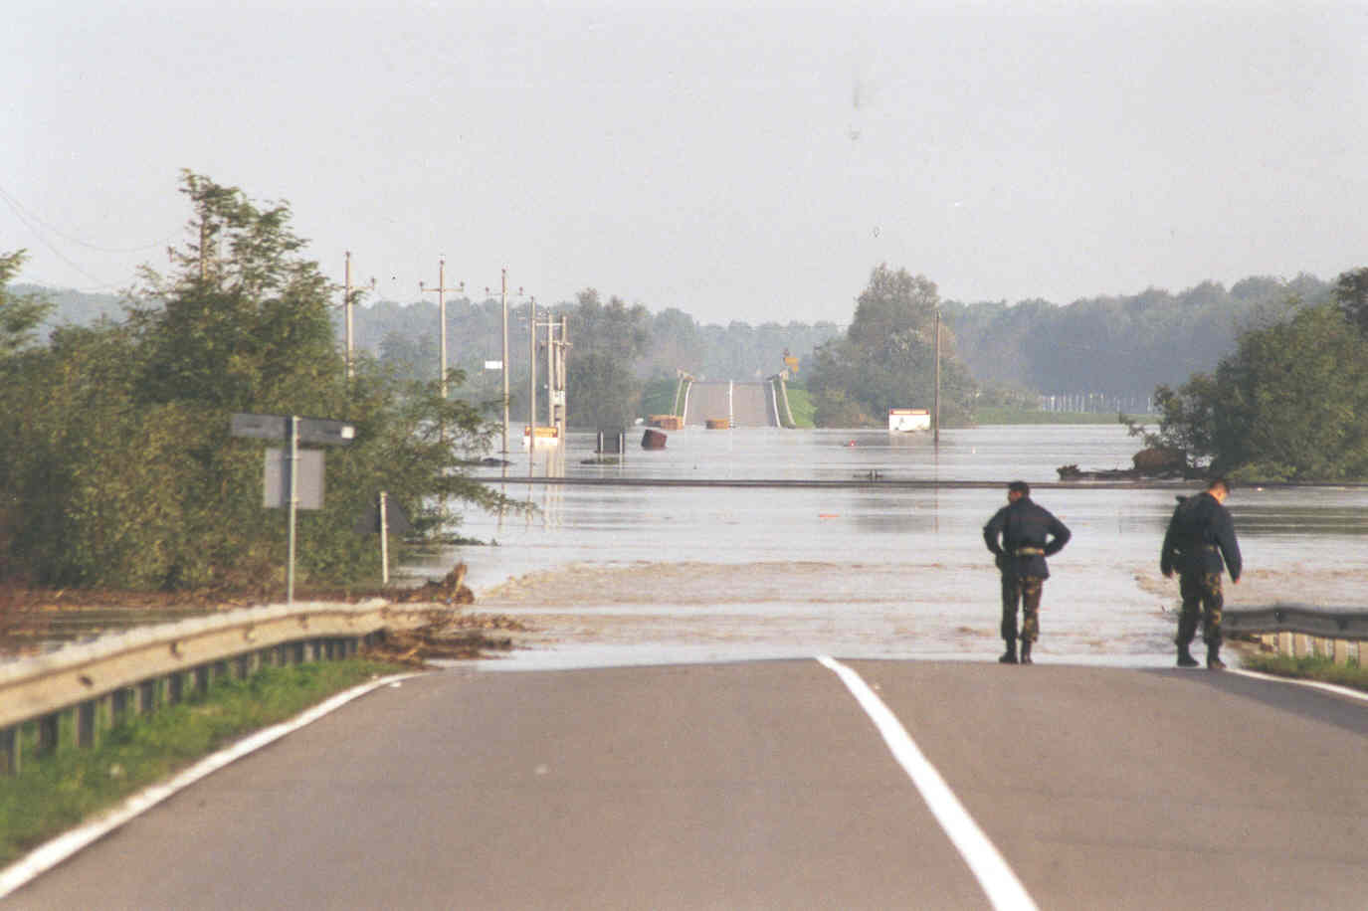
Decision making under uncertainty
Alberto Montanari
University of Bologna

Slide 2
Water Resources Management under uncertainty?
Uncertainty is always present in water resources management.
The reason is that variables like water availability, water demands etc are always affected by uncertainty.
These are meteoclimatic variables and therefore are always estimated with uncertainty.
Uncertainty can be epistemic (limited knowledge) and therefore reducible. Or can be intrinsic, and therefore irreducible.
It is compelling the evaluate the effects of uncertainty.

Slide 3
Water Resources Management under uncertainty: possible solutions
Reducing uncertainty as much as possible.
Use expected values of the uncertain variables. For instance, use expected values of monthly inflows to study optimal management of a water reservoir. The decision will produce the expected effects on average only.
Another approach is to use the most precautionary values of the variables above. This type of decision may induce a significant lost of benefit.
Errors due to uncertainty increase with increasing variability of the design variables around the expected value.

Slide 4
Water Resources Management under uncertainty: possible solutions
In some cases results may become meaningless.
Therefore uncertainty needs a careful attention.
Gambler’s paradox: let’s suppose that a gambler aims to maximise the expected value of the won money and attempts to play a game where the he has 60% probability to win. If he wins, he gets double the money he bets. If he looses, the money that he bets is lost. If an amount B is betted, the expected value of the won money is:
0.40 x 0 + 0.60 x 2B = 1.20B
which is clearly increasing with increasing B.

Slide 5
Water Resources Management under uncertainty: possible solutions
Therefore, maximisation of the expected value would suggest the gambler to bet all his amount of money any time.
But this is clearly unreasonable, because any time he risks to loose all the amount of money he gained so far.
Instead, a wise decision is indeed to bet (because the game is favorable). However, one needs to carefully evaluate how much to bet each time, depending and personal’s propensity or adversion to risk.

Slide 6
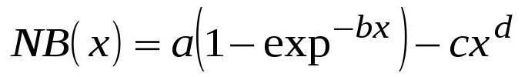
Sensitivity analysis
Sensitivity analysis aims to evaluate the effect of uncertainty on the decision.
Once the consequence of uncertainty is quantified, one is able to decide whether reducing uncertainty (for instance through new measurements) is convenient.
Example: let’s suppose that we have to estimate the optimal water allocation to an utiliser. Therefore we deal with just one decision variable. Let’s also suppose that the benefit function can be written as:

Slide 7
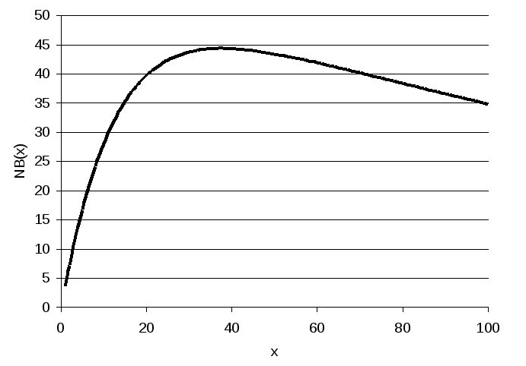
Sensitivity analysis
For a=60, b=0.08, c=1 and d=0.7 we get this type of function:
Max benefit is obtained for x = 38.

Slide 8
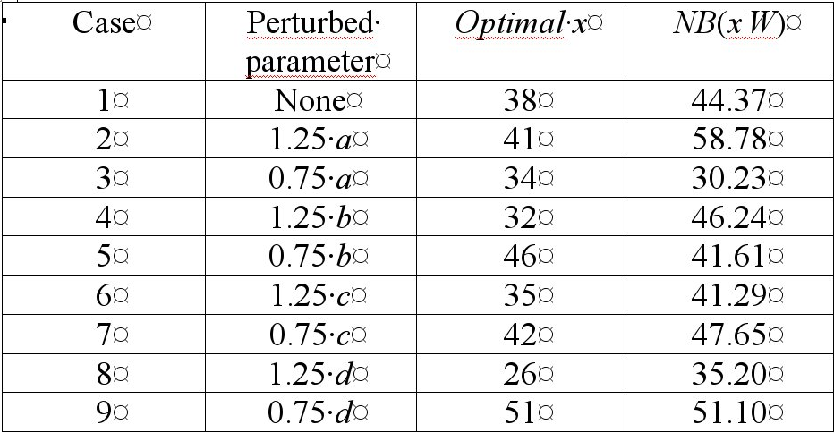
Sensitivity analysis
Sensitivity analysis is carried out by perturbing the parameter with an assigned change and recomputing the optimal x value and the related optimal benefit.

Slide 9
Sensitivity analysis
One obtains an indication of the effects of uncertainty on the benefit and an indication of the most effective parameters on the results.
However, one does not get any indication of the lost in benefit, because we need to compare the computed benefits by assuming a wrong decision with correct parameters.
Symbols:
NB(x*,W) Max benefit with optimal decision and correct parameters
NB(x’,W’) Benefit with wrong decision and wrong parameters
NB(x’,W) Benefit with wrong decision and correct parameters

Slide 10
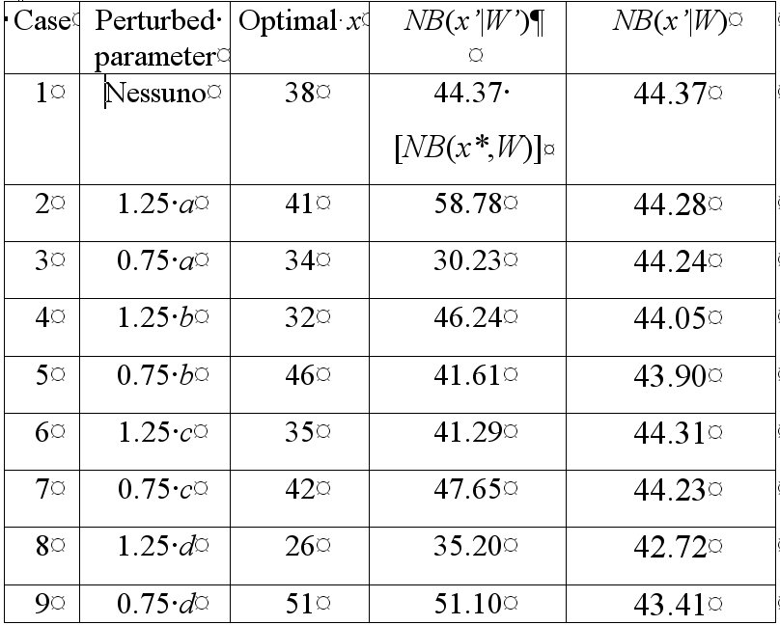
Sensitivity analysis

Slide 11
Sensitivity analysis
Loose in economic efficieny
Estimation error of the max benefit
Estimation error of the real benefit

Slide 12
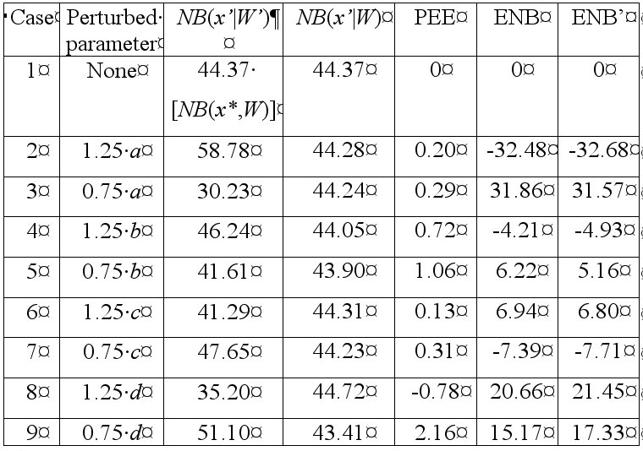
Sensitivity analysis
3.72

Slide 13
Decision under uncertainty
In the presence of uncertainty robust decisions may be preferred over optimal decisions.
Competitive solutions may exist if they do not bring to the max benefit.
Criteria of the maximum of the minimum

Slide 14
Utility theory
To each possible decision (benefit value) one must associate a value of a utility function
Utility is equal to 0 and 1 for the minimum and maximum benefit, respectively.
Utility is not decreasing for increasing benefit

Slide 15
Definition of Utility
Let us suppose that a user is asked to choose one option among the following 2:
- Get a given benefit NB(X) for sure; or
- Get the max benefit Nb_{max} with probability p or, in case
of failure, get the min benefit Nb_{min} with probability 1-p
Of course the choice of the user depends on the probability p.
The p value which makes the 2 options above equally liked by the user is defined as U[NB(X)]

Slide 16
Utility: an example of application
Let us suppose that we have to deal again with the following objective function:
where parameters can get the following values with equal probability:
a b c d
W1 = (120, 0.08, 1.0, 1.0)
W2 = (100, 0.08, 1.0, 0.8)
W3 = ( 80, 0.08, 1.0, 0.7)

Slide 17
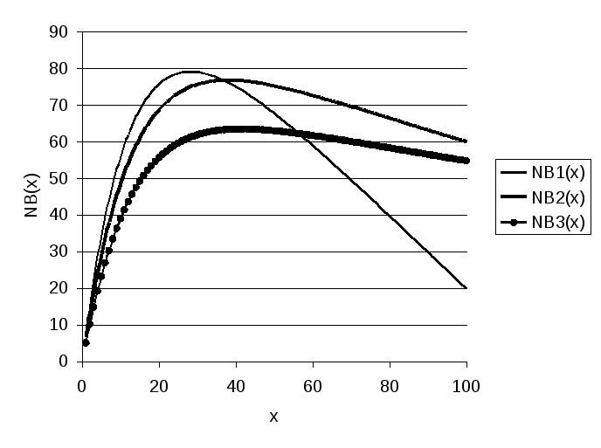
Utility: an example of application

Slide 18
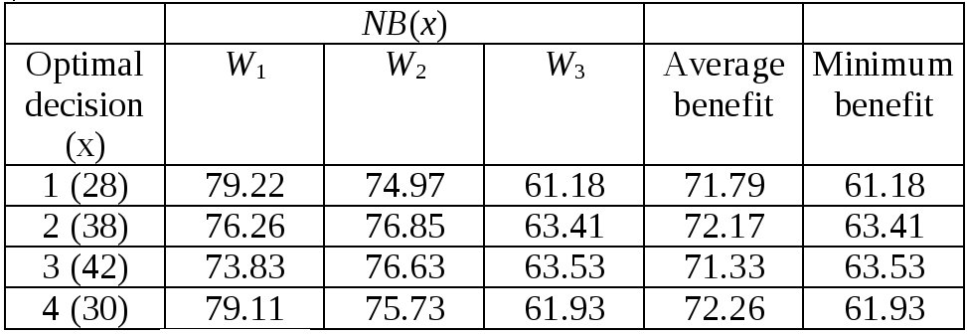
Utility: an example of application

Slide 19
Criteria for decision
Maximum average
Maximum of the minimum benefit
These criteria do not incorporate propensity or adversion to risk.

Slide 20
Utility: an example of application
Let’s assign to each of the benefits above a utility

Slide 21
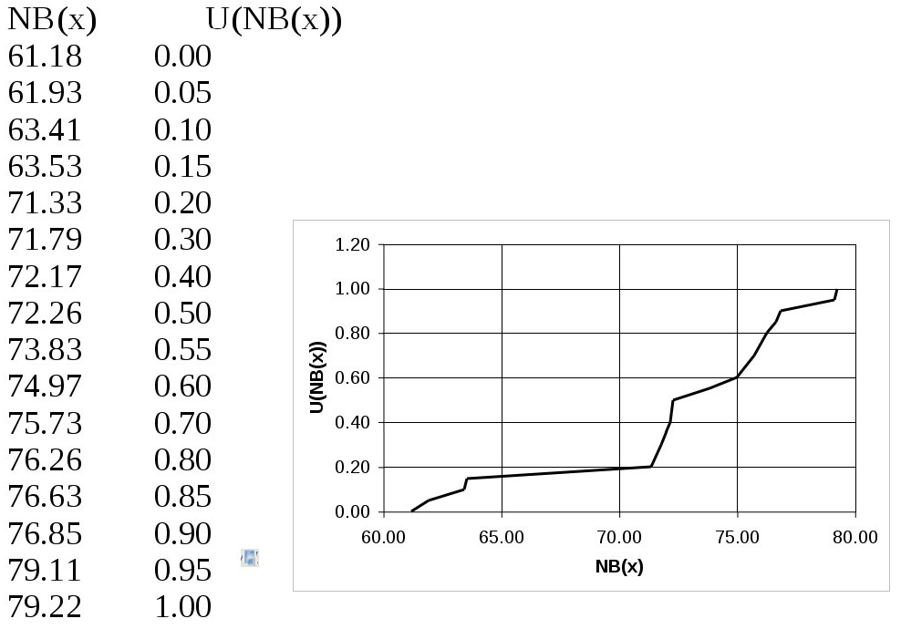
Utility: an example of application

Slide 22
Utility: an example of application
Let’s assume that we take the decision x₁=28
In terms of benefit, then we could get:
NB(28) = 79.22 with probability 1/3 → U = 1.00
NB(28) = 74.97 with probability 1/3 → U = 0.60
NB(28) = 61.18 with probability 1/3 → U = 0.00
Therefore we will have 1/3 probability to get U = 1, 1/3 to get U = 0.60 and finally 1/3 to get U = 0.
Therefore the expected value of U is:
1/3 x 1.00 + 1/3 x 0.60 + 1/3 x 0.00 = 0.53.
which means that the user does not find any difference between x₁ and a virtual decision that gives NB_{max} with probability 0.53.

Slide 23
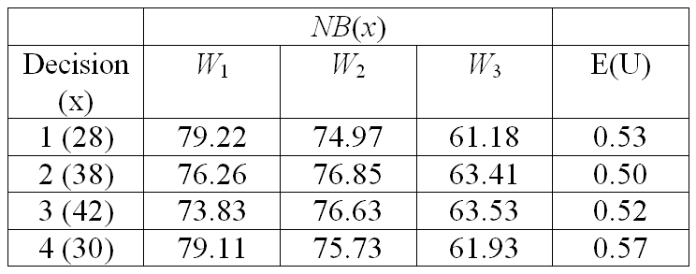
Utility: an example of application
Computation of the mean utility for each decision:

Slide 24
Propensity or adversion to risk
The progress of utility between 0 and 1 shows user’s adversity or propensity to risk.
A utility function which quickly converges to 1 denotes adversion to risk.
The opposite for a slowly increasing function.

Slide 25
Utility: pros and cons
Pros: allows one to take into account propensity or adversion to risk.
Decision is more objective.
It is transparent.
Cons: problematic definition of the utility function
Difficult to assign a utility to extremely rare events.
Definition of utility need to be done by considering different opinions.

Slide 26
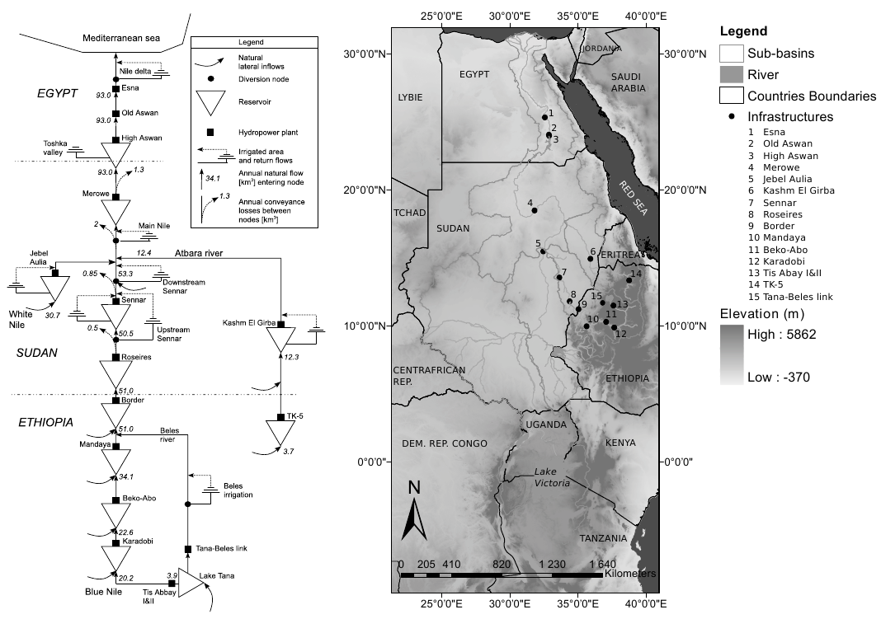
Example of a decision affected by uncertainty
Management of Nile River water resources

Slide 27
Example of a decision affected by uncertainty
Egypt, the most downstream country of the basin consumes about 80% of the Nile waters, while Ethiopia has a negligible consumption, even though 85% of the Nile waters comes from the Ethiopian Highlands (Wu and Whittington, 2006).
To secure its share of the Nile waters, Egypt has signed several agreements with its riparians: Great Britain on behalf of Sudan, Kenya, Tanzania and Uganda and with Sudan in 1959 after its independence.
Historically, those agreements were very controversial between upstream (source countries), and downstream countries (Egypt and Sudan). The most important treaty is the 1959 agreement between Egypt and Sudan about the sharing of the Nile waters. It assumes that, given an agreed upon annual average of 84 km³ of Nile yield, the allotment for Egypt is 55.5 km³ y⁻¹ while Sudan receives 18.5 km³ y⁻¹ . 10 km³ y⁻¹ are left for evaporation losses from Lake Nasser (Goor et al., 2010)

Slide 28
Example of a decision affected by uncertainty
According to the agreement, the request of another riparian country(ies) has to be met equally from Egypt’s and Sudan’s share.
All countries never recognized the treaty (Okidi, 1990; Nicol, 2003). It is important to note that, according to the 1959 bilateral agreement, the evaporation losses from man-made reservoirs in Sudan must be deducted from its share of the Nile waters.
The ﬁrst basin-wide dialogue initiative between countries has been initiated in 1997, with the Nile Basin Initiative (NBI). This organization aims at providing a framework to develop the river in a cooperative way, sharing socio-economic beneﬁts and promoting regional security and peace. The NBI has successfully developed a number of so called shared-vision, and subsidiary action projects.
However, the dialogue of the Nile riparians on a uniﬁed legal framework has not yet been completed. Five countries signed (May 2010), two countries boycotted, while the remaining two countries (Sudan and Egypt) strongly opposed (Nile Basin Initiative, May 2010a).

Slide 29
Example of a decision affected by uncertainty
Building reservoirs upstream Lake Nasser would save a lot of water from evaporation.
Siltation is also a relevant problem.
Decision is affected by uncertainty due to variability of Nile River flows.
One must identify alternative management options, and the related benefits and utilities. Utility must be estimated by involving all stakeholders in decision.
Each decision has to be tested against many realisations of Nile River flows. Stochastic processes were used to generate many realisations of Nile River flows.
Other examples of water trading among different states can be cited (Jordan river, for instance).

Slide 30
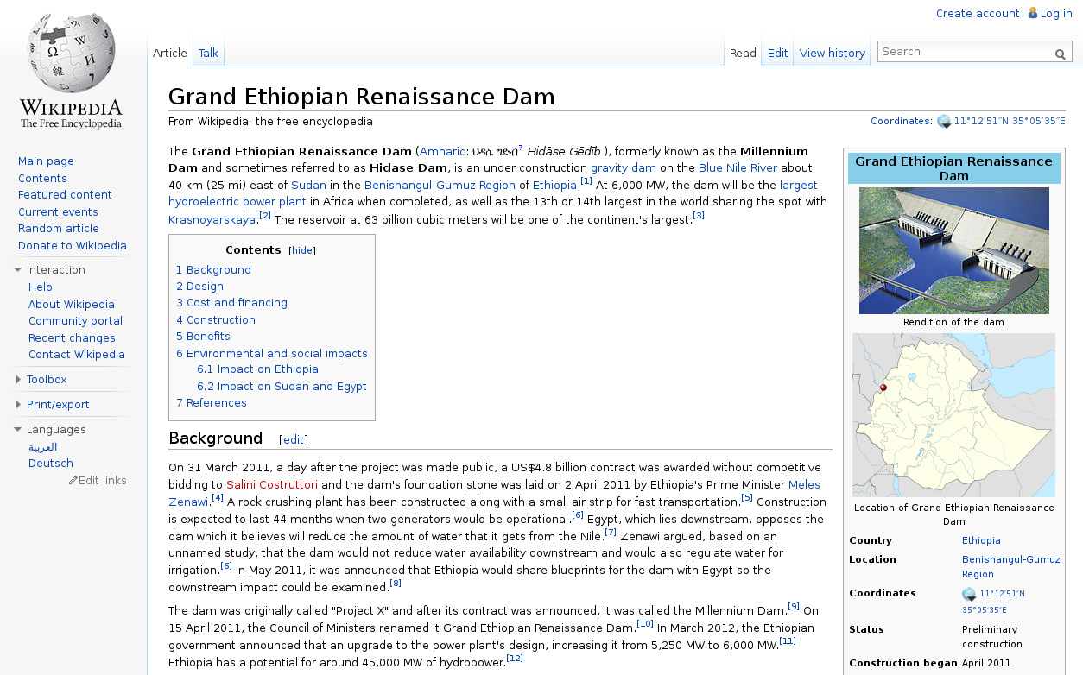
The Millenium Dam

Slide 31
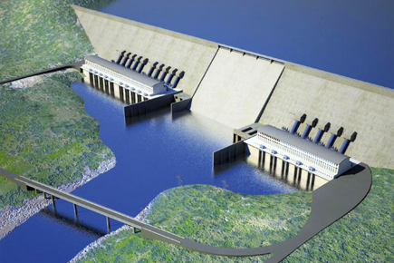
The Millenium Dam
Gravity dam – 63 billion of cubic meters of reservoir
6000 MW – largest hydroelectric power plant in Africa
Cost: 4.8 billion USD
170 m tall, 1800 long – Concrete dam
A Nile treaty signed by the upper riparian states in 2010, the Cooperative Framework Agreement, has not been signed by either Egypt or Sudan, as they claim it violates the 1959 treaty which gives Sudan and Egypt exclusive rights to the Nile's waters. The Nile Basin Initiative provides a framework for dialogue among all Nile riparian countries.

Slide 32
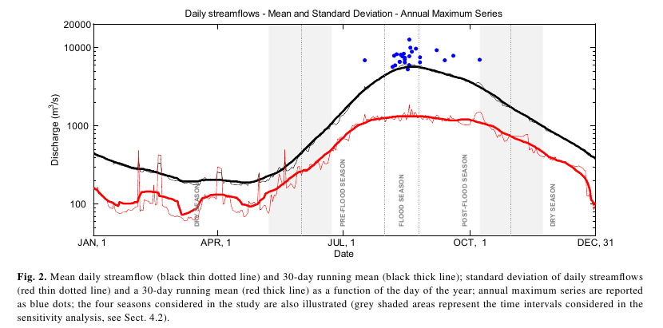
The Millenium Dam
Estimation of the Seasonal
Flood Frequency Distribution

Slide 33
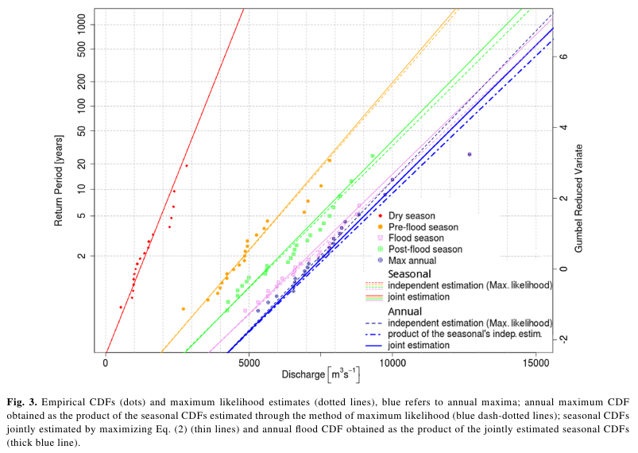
The Millenium Dam
Estimation of the Seasonal
Flood Frequency Distribution

